Slide 1

Ansible Knowing better the Tool
Presented by
Sergio Borges

Slide 2


Ansible Knowing better the Tool
About M
E
Cloud Engineer at Cisco/Layer2
Full-Time Dad
Star War Fan
Passionate for Cloud, Automation and how-to reduce the overhead of common tasks.
Love to know and speak with interesting people having a good beer
Presented by
Sergio Borges
Network Automation Engineer
https://www.linkedin.com/in/sergiocruvinelborges/

Slide 3

Introduction to Ansible
Ansible is a radically simple IT automation platform that makes your applications and systems easier to deploy.
It support configuration management with examples as below.
Configuration of servers
Application deployment
Continuous testing of already installed application
Provisioning
Automation of tasks

Slide 4
Why Automation?
Tasks in code
Collaboration
Eliminate errors
Write once
Laziness
Etc….

Slide 5


Why Ansible
It is a free open source application
Agent-less – No need for agent installation and management
Python/yaml based
Highly flexible and configuration management of systems.
Large number of ready to use modules for system management
Custom modules can be added if needed
Configuration roll-back in case of error
Simple and human readable
Self documenting

Slide 6

Ansible Configuration Management Workflow
SSH
Connection
Infrastructure

Slide 7
Ansible Documentations
You can find more info with in the Ansible Docs online help.
Ad-Hoc Commands
Inventories
Variables
Modules
Playbook Roles
https://docs.ansible.com/ansible/latest/index.html

Slide 8
Configuring Ansible Inventory Host
Do the following from Management Server machine
Create a list of client machines that you wish to configure
Create a file called : hosts
cat > hosts <<EOF
[servers]
10.102.32.11
10.102.32.12
10.102.32.1[3:4]
[servers:vars]
ansible_ssh_user=root
ansible_ssh_pass=root
EOF

Slide 9
Creating the First ansible-playbook
Create a template to execute “install and start” WebServer with content as shown below and save as web role.
---
- name: Install and start Apache
hosts: webserver
connection: local
tasks:
- name: Install Repo
yum: name=epel-release state=present
- name: install python binding Selinux
yum: name={{item}} state=present
with_items:
- libselinux-python
- libsemanage-python
- name: test if Selinux is running
command: getenforce
register: sestatus
changed_when: false
- name: install apache
yum:
name: "{{ packages }}"
vars:
packages:
- httpd
- httpd-tools
- name: restart Apache Services
service:
name: httpd
state: present
enabled: yes

Slide 10

TIPS for Playbooks
Playbooks are idempotent, meaning change commands are not run unless needed.
Every playbook configuration always begins with triple dash (---)
Playbooks doesn’t recognize tabs only SPACES for organize the structure.
Playbooks has the Follow basic sections:
NAME: good for keeping the Playbooks readable and what the playbook try to run
HOST: identifies the target for Ansible to run against
TASKS: Here is where all steps of playbook will follow
Playbooks use the concept of key:value pair to define the content
Debug can be executed on specific task or also from all playbook execution
E.g : ansible-playbook main.yml --vvv (each V can show more information max: 4 )

Slide 11
Templating with Ansible (Jinja2)
Ansible uses Jinja2 templating to enable dynamic expressions and access to variables.
It is possible to add programming Logic on each template to automate your task and each Field content between
{{ variable name }} will call a key:value variable referenced on files or embedded on Playbook.
<html>
<head>
<title>Ansible Application</title>
</head>
<body>
</br>
<a href=http://{{ ansible_default_ipv4.address }}/index.html>Homepage</a>
</br>
<?php
Print "Hello, World! I am a web server configured using Ansible and I am : ";
echo exec('hostname’);
Print "</BR>";
echo "List of Databases: </BR>";
{% for host in groups['dbservers'] %}
$link = mysqli_connect('{{ hostvars[host].ansible_default_ipv4.address }}', ‘{{ hostvars[host].dbuser }}', '{{ hostvars[host].upassword }}') or die(mysqli_connect_error($link));
{% endfor %}
$res = mysqli_query($link, "SHOW DATABASES;");
while ($row = mysqli_fetch_assoc($res)) {
echo $row['Database'] . "\n";
}
?>
</body>
</html>
https://docs.ansible.com/ansible/latest/modules/template_module.html

Slide 12
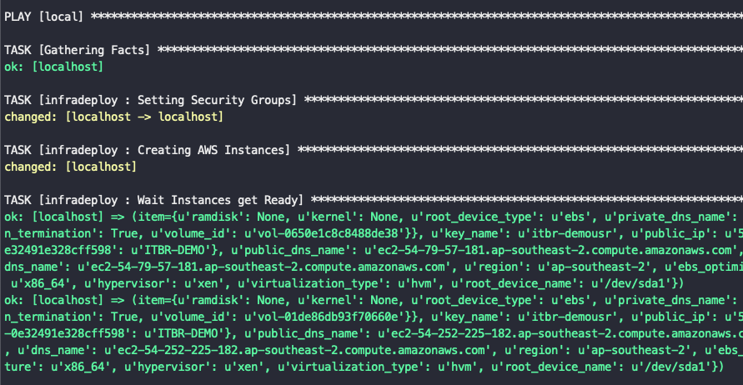
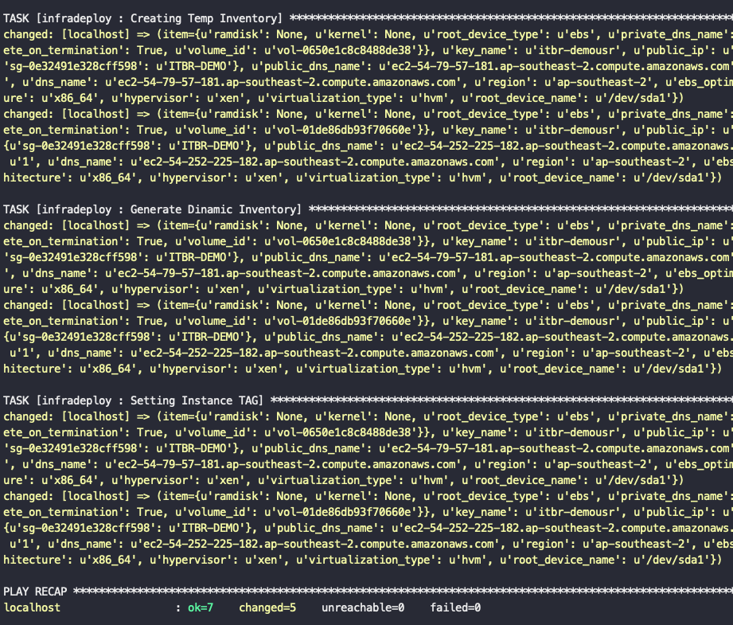
Understanding ansible playbook
The output of the ansible-playbook command as below

Slide 13
DEMO LAB

Slide 14
It’s time to be a Hero
Let’s automate!
Thank you
Download the source code:
https://github.com/borgessc/ansible_it.br
ansiblenetwork.slack.com

Slide 15
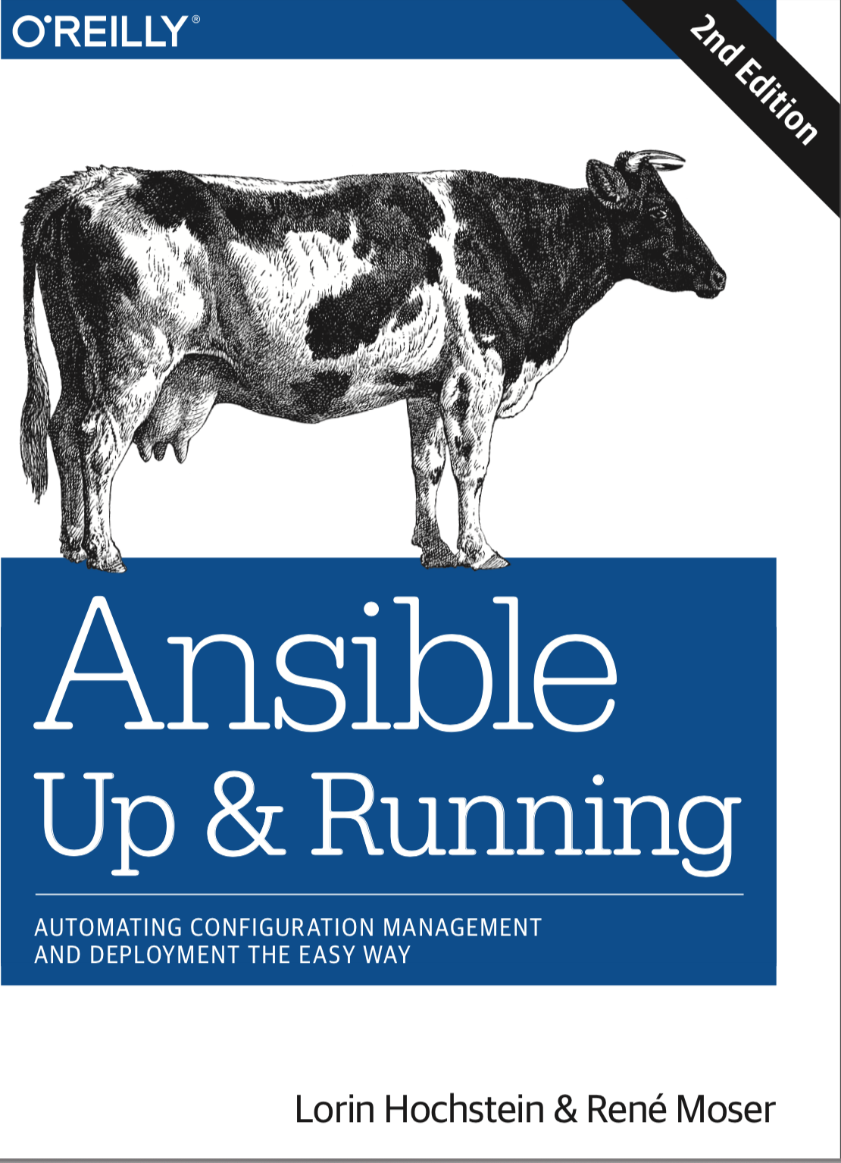
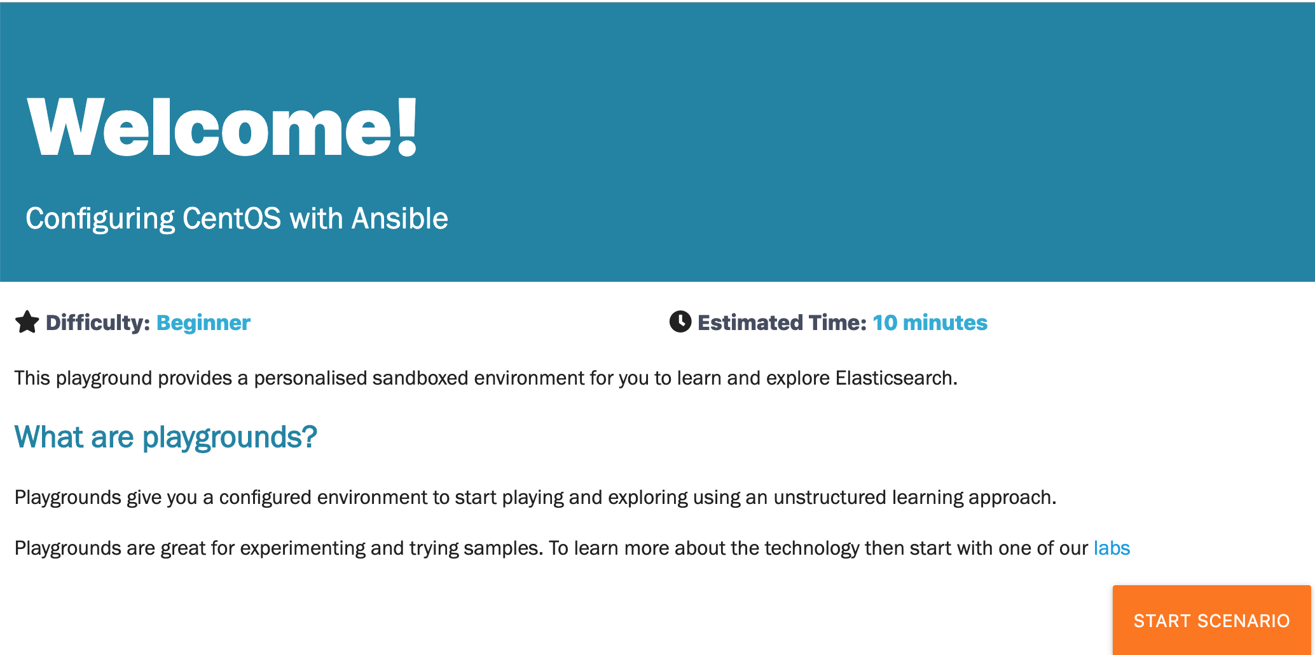
Book Support and LAB
https://www.katacoda.com/courses/ansible/centos
https://bit.ly/2mgl75W

